Slide 1


Allergen Chip Challenge Winner’s Presentation
Rakesh Jarupula
Notes:
Recommending picking out he most interesting and important parts from your documentation.

Slide 2
Agenda

Slide 3
Agenda
Background
Solution Summary
Feature selection & engineering
Modeling
Important findings
Question and Answers

Slide 4
Background

Slide 5
Background
Data Scientist – Freelance
Bachelor’s in Electrical Engineering from NIT Silchar
Contributed to 20+ competitions and hackathons

Slide 6
Summary

Slide 7
Summary
Ensemble of XGBoost, LightGBM and CatBoost.
Decision threshold is tuned to account Imbalance.
Created an Allergen to its source and route Excel file.
Feature Engineering is the key.

Slide 8
Features Selection/
Engineering

Slide 9
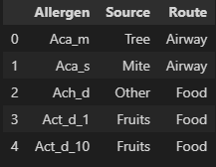
Features Engineering
Aggregated different allergens based on their source and way of entering the human body.
Treatment types features.
Row based features – Missing value counts, Zero counts and some statistical values.

Slide 10
Features Selection
Only the features that are relevant to the target are used.
Some irrelevant allergen features are dropped, and Outlier are treated.

Slide 11
Features Selection/Engineering
Features Selection/Engineering
Variable Importance Plot
Variable Importance Plot - XGB

Slide 12
Modeling

Slide 13
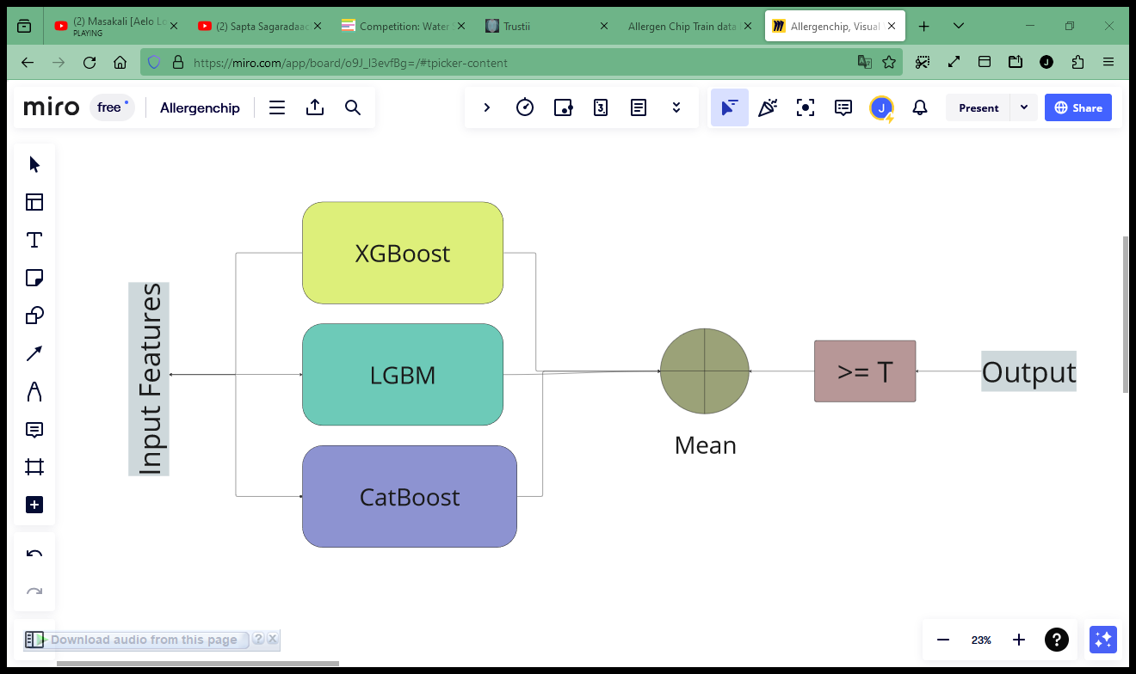
Training Methods

Slide 14
Training Methods
Separate model for each Target variable – ChainClassifier didn’t perform that well.
Imbalance - scale_pos_weights
Repeated Stratified KFold (5x5).
Bayesian Search CV for Hyperparameters.

Slide 15
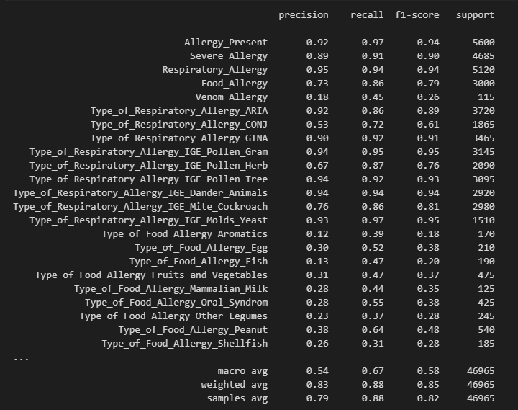
Training Methods
Evaluation

Slide 16
Important and Interesting Findings

Slide 17
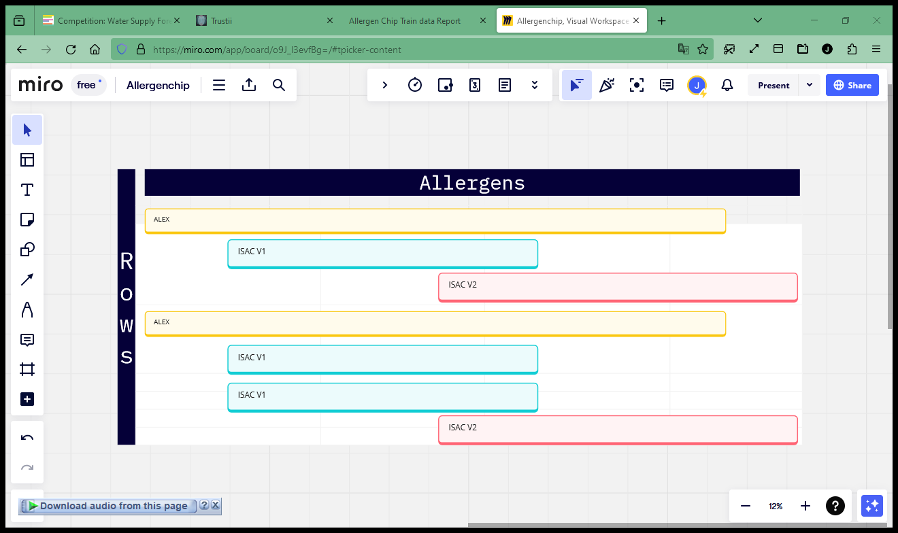
Important and Interesting Findings
Chip used to measure allergens may have some effect.
ALEX – 18 missing, ISAC_V1 & V2 – 206 missing (out of 318)
70% rows are measured by ISAC chips

Slide 18
Important and Interesting Findings
Information about the treatment is important.
Demographical information may increase predictive capability.

Slide 19
References

Slide 20
References
http://www.allergen.org/index.php
https://www.ncbi.nlm.nih.gov/
https://www.medicalexpressclinic.co.uk/public/design/pdf/example-of-alex-allergy-test-result.pdf
https://www.youtube.com/watch?v=-9Ef5lvrvZ4
https://www.youtube.com/watch?v=klET1jLVmp4

Slide 21
Question and Answer

